Slide 1
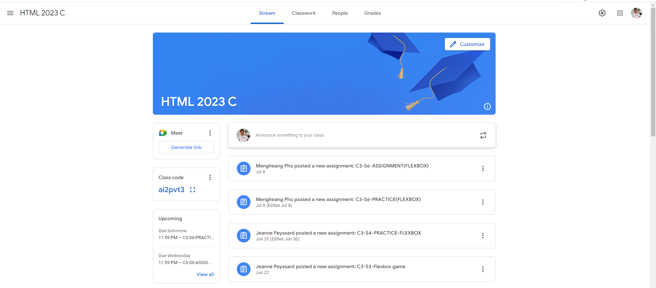
Identify root components of website below

Slide 2
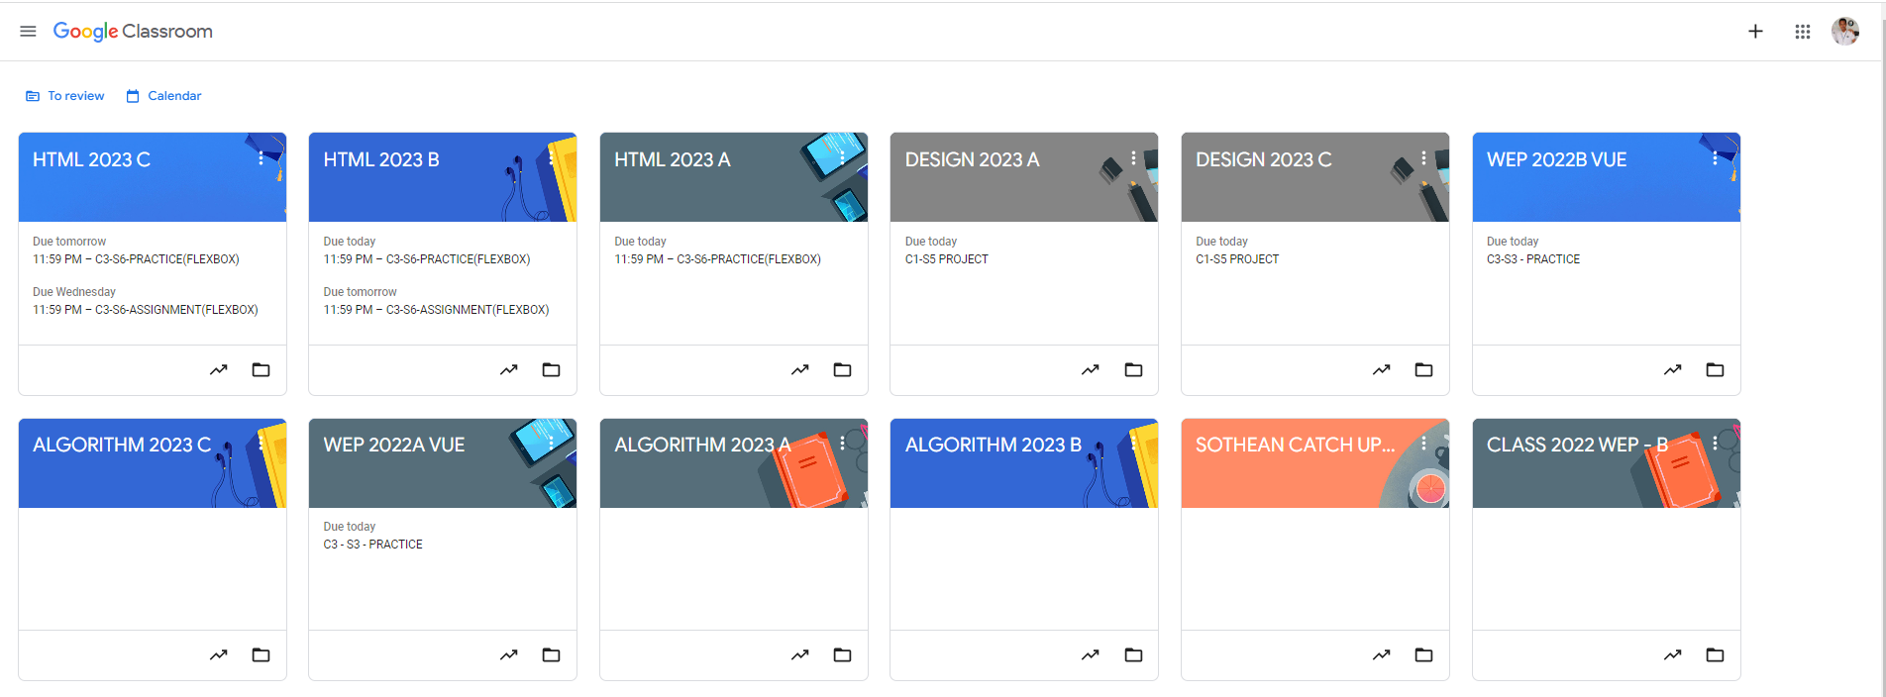
Root div
- Height: 100vh
content
nav
Flex: 0
header
Flex: 0
Flex: 1

Slide 3
Root div
- Height: 100vh
main
nav
Flex: 0
Flex: 1

Slide 4
nav div
- Height: 10vh
nav-left
nav-center
nav
Flex: 0
Flex: 1
Flex: 0
flex-direction: row

Slide 5
main div
main-top
Flex: 0
main-bottom
Flex: 1

Slide 6
main-top div
flex-direction: row
top-left
Flex: 0
top-right
Flex: 0

Slide 7
main-bottom div
sidebar
content
flex-direction: row
Flex: 0
Flex: 1

Slide 8
sidebar div
Flex: 0
sidebar-link
sidebar-code
Flex: 0
Sidebar-upcoming
Flex: 1

Slide 9
content div
Flex: 0
announce
activity
Flex: 1

Slide 10
announce div
Announce-left
announce-right
flex-direction: row
Flex: 1
Flex: 0

Slide 11
activity div
activity-left
activity-right
flex-direction: row
Flex: 1
Flex: 0

